Slide 1
Autoencoders
CMPUT 328
Nilanjan Ray
Picture source: “Hands on Machine Learning with Scikit-Learn & TensorFlow” by Aurelien Geron

Slide 2
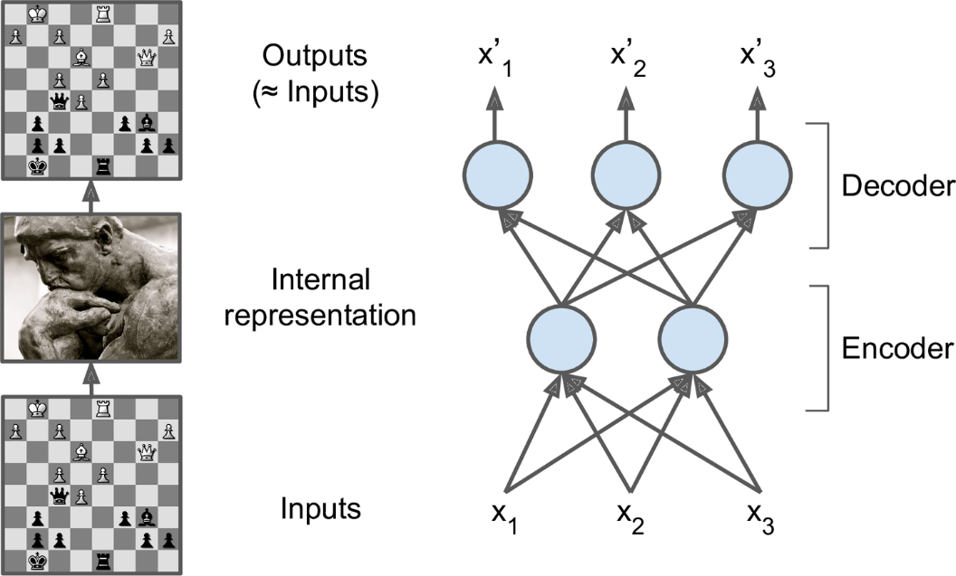
Representation learning by autoencoders
Can we learning interesting, hidden
representations from unlabeled data?

Slide 3
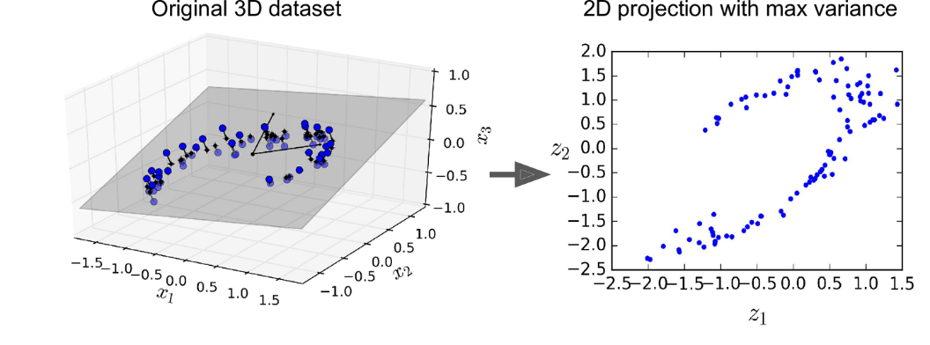
Extract underlying (low) dimensionality
Even though the data points are 3D, they more or less lie on a 2D plane.

Slide 4
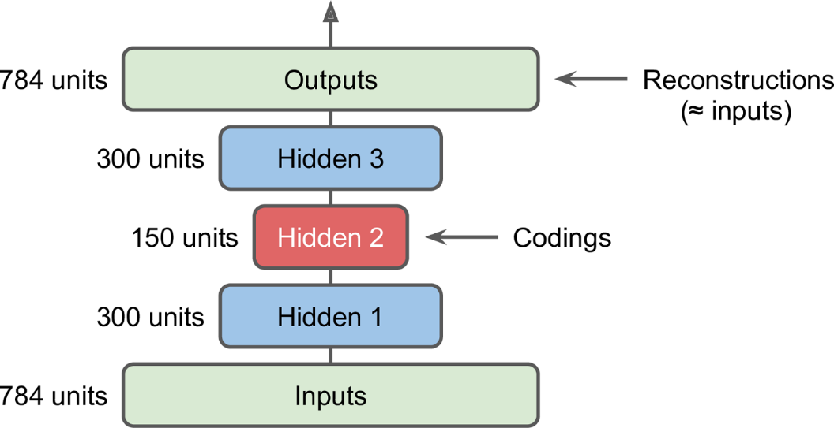
An example autoencoder for MNIST
MNIST_AE.ipnyb implements this architecture

Slide 5
Convolutional AE
We can easily replace fully connected layers by all convolutional layers with proper padding
Look at MNIST_AE.ipnyb

Slide 6
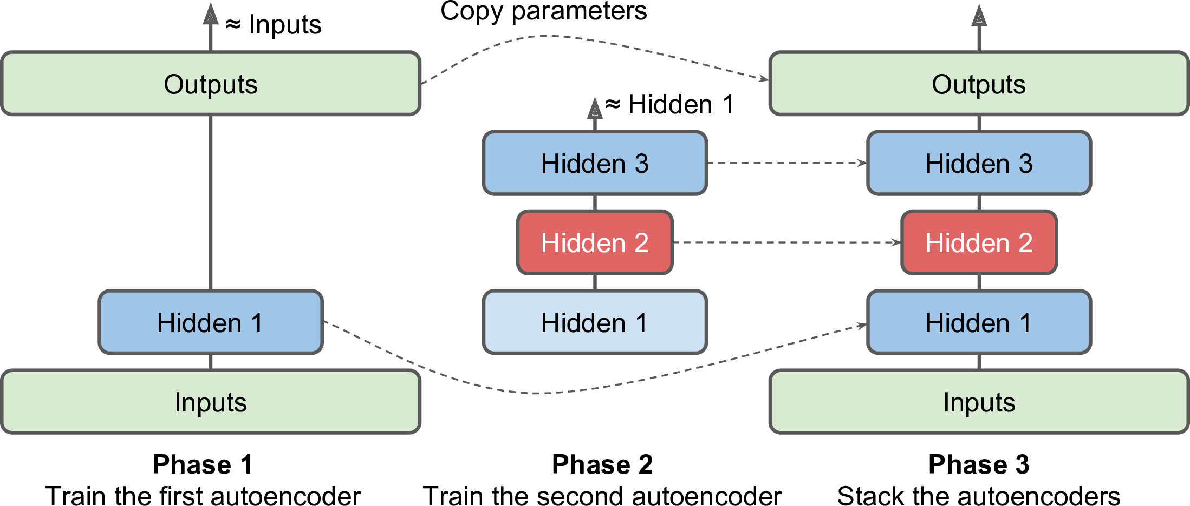
Phased training in AE

Slide 7
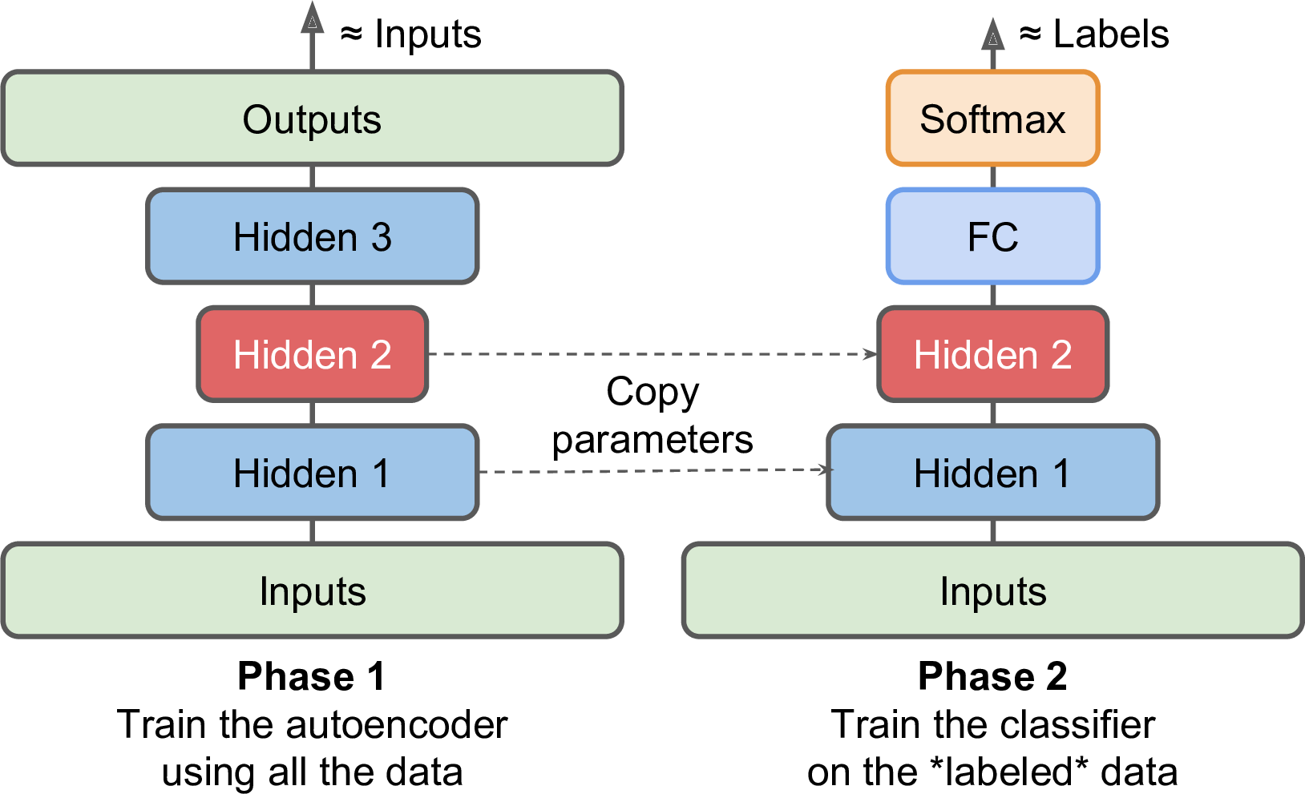
Classification from AE

Slide 8
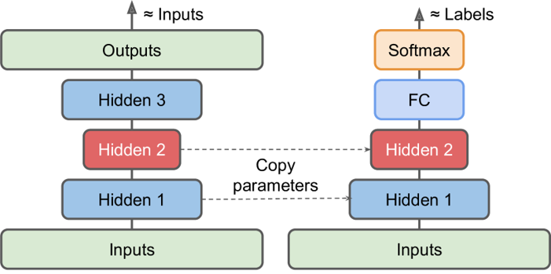
Semi-supervised learning
Often, labeled data is partially available: maybe 80% training data is unlabeled, only 20% is labeled. How do we make
use of unlabeled data during training a classifier?

Slide 9
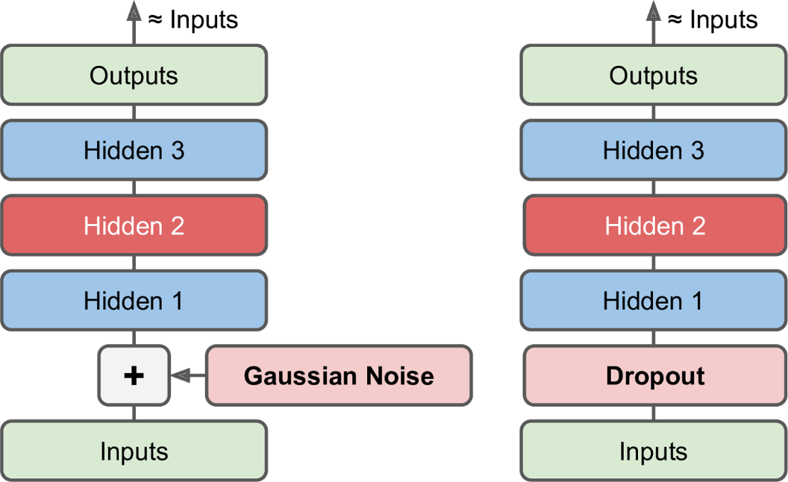
Denoising AE
Add noise or insert a dropout layer

Slide 10
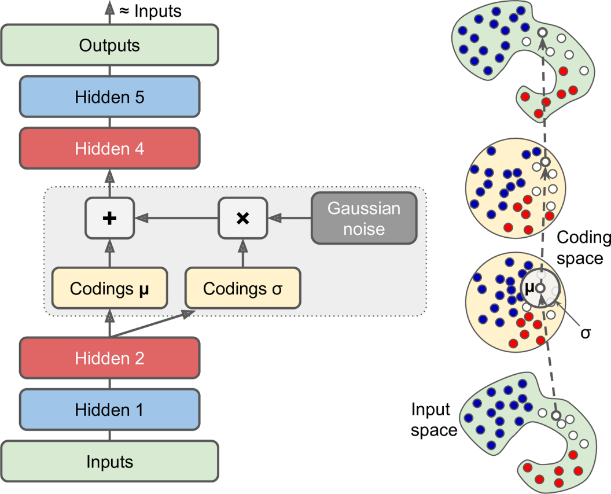
Variational AE
Cost function has two components:
Reconstruction + constraint for μ and σ
The constraint: the encoded distribution
should look like a zero-mean, unit variance
Gaussian.
The advantage is that you can generate
data (images) that look like the training
images.

